Slide 1
A Weighted Exact Test for Significance of Mutually Exclusive Mutations in Cancer
Max Leiserson
ISMB Late Breaking Research
July 10th, 2016
In collaboration with Matthew Reyna and Benjamin Raphael

Slide 2
Driver mutations cause cancer
Individuals acquire somatic mutations over time
Increased cell growth and rapid accumulation of mutations
Adapted from: [Stratton, et al., Nature 2009]
Time
Fertilized egg
Infancy
Early tumor
Invasive cancer
“Typical tumor”
1-10 driver mutations
10s-1000s of passenger mutations
= driver mutation
= passenger mutation

Slide 3
Driver mutations target pathways
A
Pathway: group of genes (typically dozens) that interact to perform some function.
B
= Protein
= Interaction
= Pathway
C
Cancer requires mutations to multiple key pathways, e.g.
DNA damage repair pathway
Cell growth pathway
Cell invasion pathway
= Driver mutation
Each pathway can be perturbed in multiple ways
→ Different combinations of mutations cause cancer in different patients.

Slide 4
Driver mutations in pathways are often mutually exclusive
Approximately one driver mutation per pathway per patient
Genes/Loci
Patients
[Thomas, et al. 2007]
Few driver mutations distributed across multiple pathways.
No fitness advantage for multiple mutations in the same pathway.
Dendrix [Vandin, et al. RECOMB 2011]
Muex [Szczurek, et al. RECOMB 2014]
MEMCover [Kim, et al. ISMB 2015]
Mutex [Babur, et al. Genome Biology 2015]
…

Slide 5
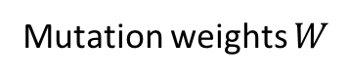
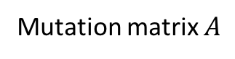
Contributions
WExT: New Weighted Exclusivity Test for mutations in cancer
Efficiently approximates two commonly used statistical tests for mutual exclusivity
Improves upon earlier methods at analyzing tumors with high mutation rates
Mutation matrix $A$
5
M
14
15
14
Genes
10
5
7
14
12
9
3
3
3
2
3
2
7
3
2
3
2
6
3
4
3
2
3
3
2
4
3
2
7
2
3
2
3
4
2
2
2
3
2
2
2
1
Patients
Mutation weights $W$
Genes
[Leiserson, Reyna, & Raphael. ECCB/Bioinformatics 2016 (to appear)]
Patients

Slide 6
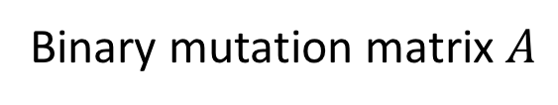
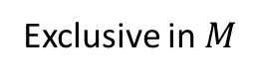
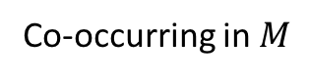
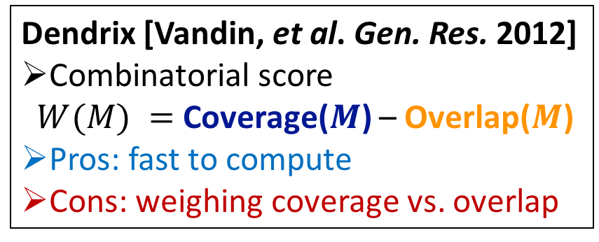
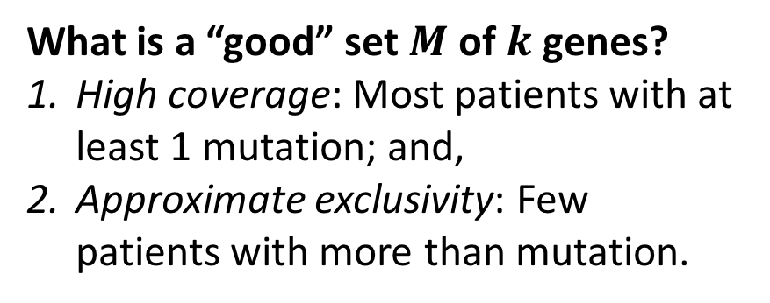
Scoring sets of mutually exclusive mutations
What is a “good” set $M$ of $k$ genes?
High coverage: Most patients with at least 1 mutation; and,
Approximate exclusivity: Few patients with more than mutation.
Binary mutation matrix $A$
M
Dendrix [Vandin, et al. Gen. Res. 2012]
Combinatorial score $W(M) =$ Coverage($M$) – Overlap($M$)
Pros: fast to compute
Cons: weighing coverage vs. overlap
Genes
Patients
Coverage(M)
Exclusive in $M$
Co-occurring in $M$
Mutated
Not mutated
Notes:
What does good set look like? -> Binary matrix, row submatrix -> most patients with at least one Vandin et al introduced the first score -> Combinatorial (Coverage – Overlap)→ Number of patients with at least one mutation minus number of co-occurring mutations -> blue minus orange ->Very fast to compute -> But can have problems on real data when coverage dominates overlap

Slide 7
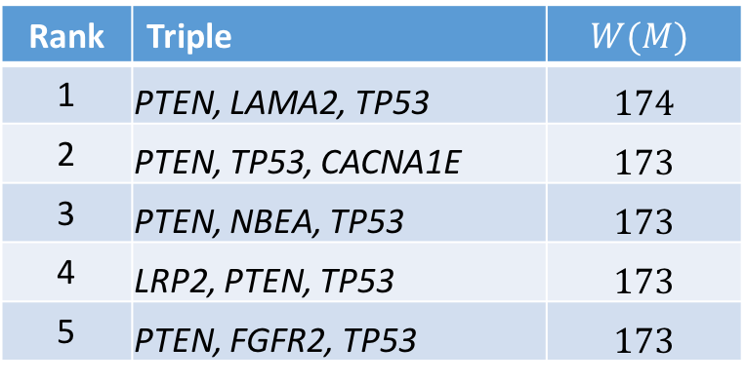
Dendrix on TCGA endometrial carcinomas
248 endometrial carcinomas [TCGA, Nature 2014]
Rank | Triple | $$W(M)$$
1 | PTEN, LAMA2, TP53 | $$174$$
2 | PTEN, TP53, CACNA1E | $$173$$
3 | PTEN, NBEA, TP53 | $$173$$
4 | LRP2, PTEN, TP53 | $$173$$
5 | PTEN, FGFR2, TP53 | $$173$$
PTEN (161)
TP53 (69)
LAMA2 (30)
Coverage: 88% (217/248 patients)
Adds about the same coverage and overlap!
Top five Dendrix triples on endometrial cancers.

Slide 8
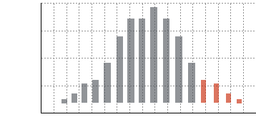
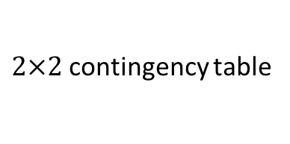
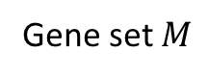
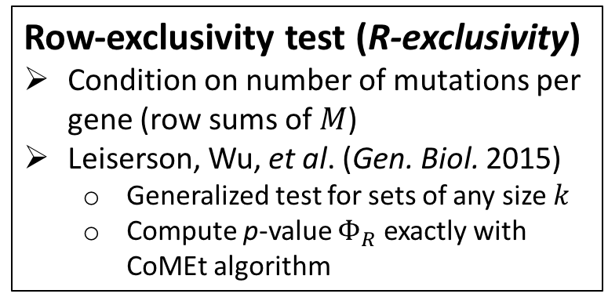
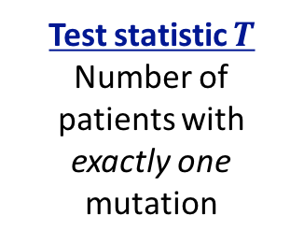
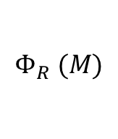
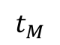
Statistical score for mutual exclusivity conditioning on gene frequencies
Surprise of mutual exclusivity conditioned on each gene’s mutation frequency
Gene 2
Gene 1
14
 | Not Mutated | Mutated
Not mutated | 6 | 13
Mutated | 8 | 1
Gene 1
Gene 2
9
Gene set $M$
$2×2$contingency table
row sum = number of mutations per gene
Row-exclusivity test (R-exclusivity)
Condition on number of mutations per gene (row sums of $M$)
Leiserson, Wu, et al. (Gen. Biol. 2015)
Generalized test for sets of any size $k$
Compute p-value $Φ_{R}$ exactly with CoMEt algorithm
$$Φ_{R} (M)$$
Test statistic $T$
Number of patients with exactly one mutation
Hypergeometric probability
$$t_{M}$$
Exclusivity
One-sided Fisher’s Exact Test for independence

Slide 9
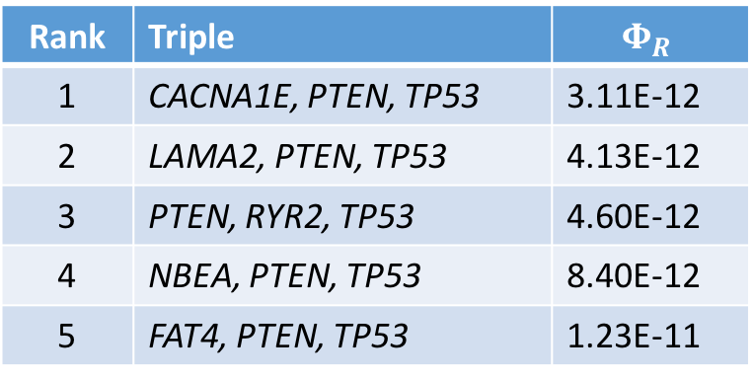
CoMEt on TCGA endometrial carcinomas
248 endometrial carcinomas [TCGA, Nature 2014]
Rank | Triple | $$Φ_{R}$$
1 | CACNA1E, PTEN, TP53 | 3.11E-12
2 | LAMA2, PTEN, TP53 | 4.13E-12
3 | PTEN, RYR2, TP53 | 4.60E-12
4 | NBEA, PTEN, TP53 | 8.40E-12
5 | FAT4, PTEN, TP53 | 1.23E-11
PTEN (161)
TP53 (69)
CACNA1E (31)
Coverage: 88% (217/248 patients)
Top five CoMEt triples on endometrial cancers.

Slide 10
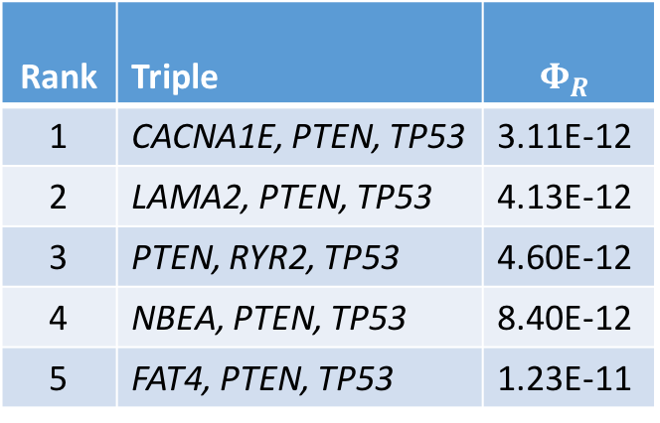
CoMEt on TCGA endometrial carcinomas
248 endometrial carcinomas (81 hypermutators) [TCGA, Nature 2014]
hypermutators
Rank | Triple | $$Φ_{R}$$
1 | CACNA1E, PTEN, TP53 | 3.11E-12
2 | LAMA2, PTEN, TP53 | 4.13E-12
3 | PTEN, RYR2, TP53 | 4.60E-12
4 | NBEA, PTEN, TP53 | 8.40E-12
5 | FAT4, PTEN, TP53 | 1.23E-11
PTEN (161)
TP53 (69)
CACNA1E (31)
Coverage: 88% (217/248 patients)
Top five triples on endometrial cancers from CoMEt.
= hypermutator
= non-hypermutator

Slide 11
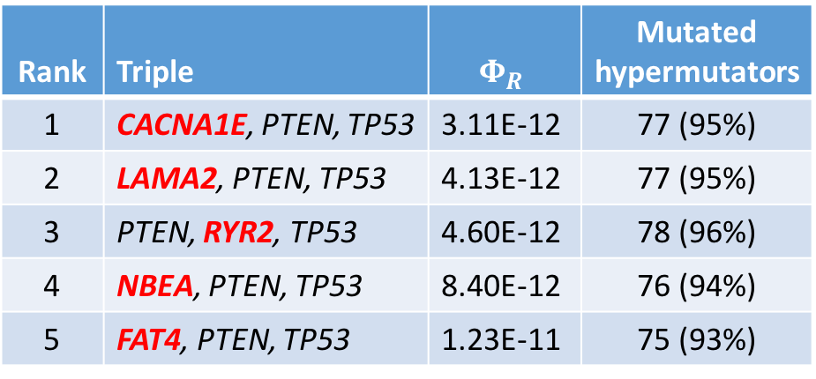
CoMEt on TCGA endometrial carcinomas
248 endometrial carcinomas (81 hypermutators) [TCGA, Nature 2014]
hypermutators
Rank | Triple | $$Φ_{R}$$ | Mutated hypermutators
1 | CACNA1E, PTEN, TP53 | 3.11E-12 | 77 (95%)
2 | LAMA2, PTEN, TP53 | 4.13E-12 | 77 (95%)
3 | PTEN, RYR2, TP53 | 4.60E-12 | 78 (96%)
4 | NBEA, PTEN, TP53 | 8.40E-12 | 76 (94%)
5 | FAT4, PTEN, TP53 | 1.23E-11 | 75 (93%)
PTEN (161)
TP53 (69)
CACNA1E (31)
Coverage: 88% (217/248 patients)
Top five triples on endometrial cancers from CoMEt.
Genes with proteins longer than 11,000 amino acids → more likely to be mutated randomly!
= hypermutator
= non-hypermutator

Slide 12
Mutation rates vary across tumors
[Lawrence, et al. Nature, 2013]
Number of mutations per tumor varies over several orders of magnitude
Multiple causes
Environmental (e.g., UV light)
Faulty DNA damage repair (e.g., microsatellite instability)
…

Slide 13
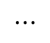

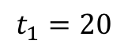
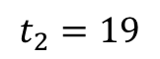
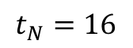
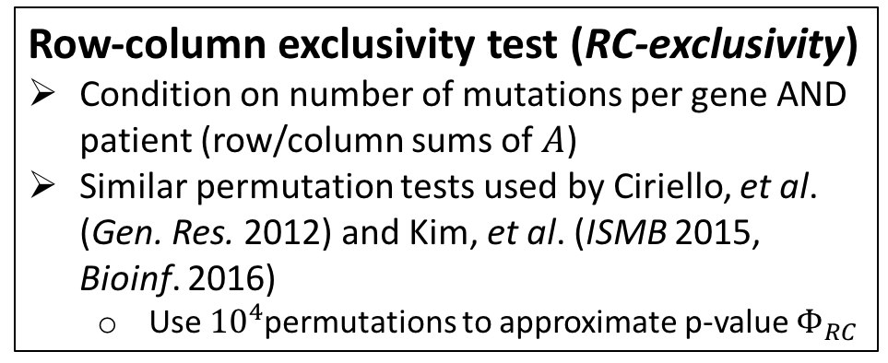
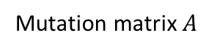
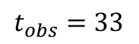
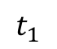
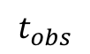
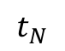
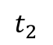
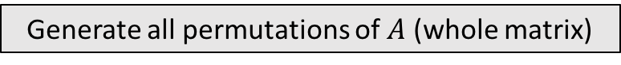
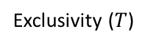
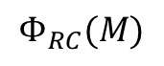

Statistical score for mutual exclusivity conditioning on gene and patient frequencies
Mutation matrix $A$
row sum = number of mutations per gene
Generate all permutations of $A$ (whole matrix)
5
Fix row and column sums of $A$
M
14
15
14
Genes
10
5
$$⋯$$
7
14
$$t_{obs}=33$$
12
$$t_{1}=20$$
$$t_{2}=19$$
$$⋯$$
$$t_{N}=16$$
9
3
3
3
2
3
2
7
3
2
3
2
6
3
4
3
2
3
3
2
4
3
2
7
2
3
2
3
4
2
2
2
3
2
2
2
Patients
1
Column sums = number of mutations per patient
Row-column exclusivity test (RC-exclusivity)
Condition on number of mutations per gene AND patient (row/column sums of $A$)
Similar permutation tests used by Ciriello, et al. (Gen. Res. 2012) and Kim, et al. (ISMB 2015, Bioinf. 2016)
Use ${10}^{4}$permutations to approximate p-value $Φ_{RC}$
Compute distribution of exclusivity $T$
$$t_{2}$$
$$t_{1}$$
$$t_{N}$$
$$Φ_{RC}(M)$$
$$t_{obs}$$
Density
Exclusivity ($T$)
Notes:
Use a statistical score fixing # mutations per patient and # mutations per gene-> Fix column sums of A -> how to compute? -> choose same gene set M -> generate all permutations of A with fixed row/column sums -> gives distribution to compute p-value -> call row-column exclusivity, because conditioning on both # mutations per gene/patient -> used by previous researchers -> can’t compute exactly → have to examine entire matrix

Slide 14
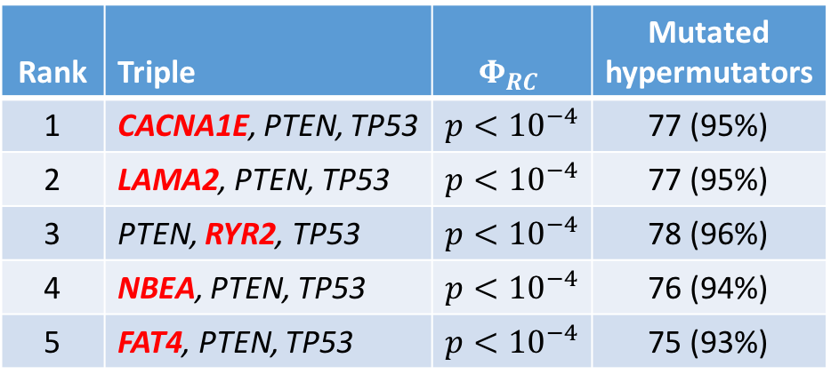
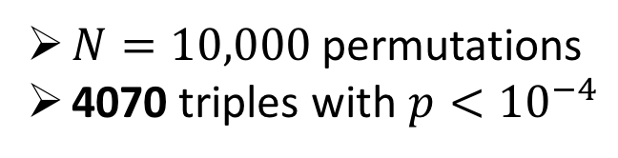
RC-exclusivity on TCGA endometrial carcinomas
248 endometrial carcinomas (81 hypermutators) [TCGA, Nature 2014]
hypermutators
Rank | Triple | $$Φ_{RC}$$ | Mutated hypermutators
1 | CACNA1E, PTEN, TP53 | $$p<{10}^{−4}$$ | 77 (95%)
2 | LAMA2, PTEN, TP53 | $$p<{10}^{−4}$$ | 77 (95%)
3 | PTEN, RYR2, TP53 | $$p<{10}^{−4}$$ | 78 (96%)
4 | NBEA, PTEN, TP53 | $$p<{10}^{−4}$$ | 76 (94%)
5 | FAT4, PTEN, TP53 | $$p<{10}^{−4}$$ | 75 (93%)
Challenges for RC-exclusivity
Cannot compute small p-values accurately
Computationally expensive
$N=10,000$ permutations
4070 triples with $p<{10}^{−4}$

Slide 15
Weighted exact test for mutual exclusivity
Mutation matrix $A$
Weighted exact test for exclusivity uses per gene, per patient mutation probabilities
Compute p-values exactly or with saddlepoint approximation (fast!)
Generalizes R-exclusivity
Quickly and accurately approximates RC-exclusivity
5
M
14
15
14
Genes
10
5
7
14
12
9
3
3
3
2
3
2
7
3
2
3
2
6
3
4
3
2
3
3
2
4
3
2
7
2
3
2
3
4
2
2
2
3
2
2
2
1
Patients
Mutation weights $W$
Genes
[Leiserson, Reyna, & Raphael. ECCB/Bioinformatics 2016 (to appear)]
Patients

Slide 16
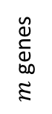
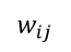
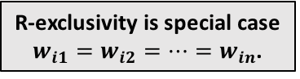

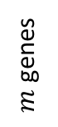

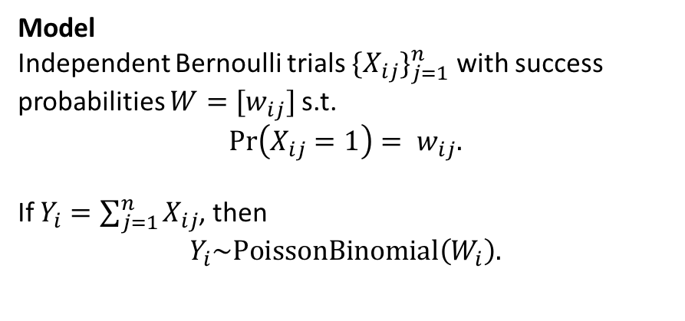
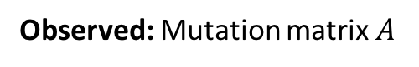
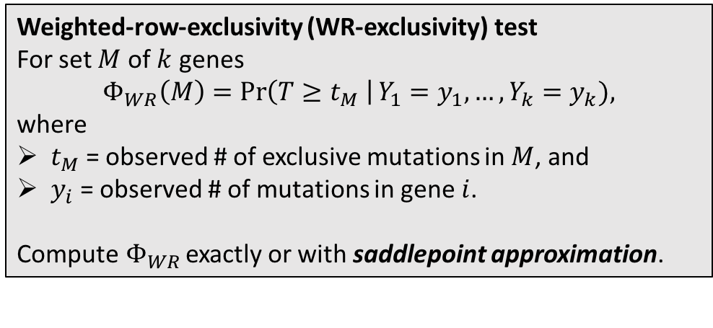


Weighted exact test for mutually exclusive mutations
Observed: Mutation matrix $A$
Model
Independent Bernoulli trials ${\{X_{ij}\}}_{j=1}^{n}$ with success probabilities $W=[w_{ij}]$ s.t.
$$\operatorname{Pr}\left(X_{ij}=1\right)= w_{ij}.$$
If $Y_{i}=\sum_{j=1}^{n}{X_{ij}}$, then
$$Y_{i}\sim \text{PoissonBinomial}\left(W_{i}\right).$$
5
$$M$$
14
15
14
$m$ genes
10
R-exclusivity is special case $w_{i1}=w_{i2}=⋯=w_{in}$.
5
7
14
12
9
3
3
3
2
3
2
7
3
2
3
2
6
3
4
3
2
3
3
2
4
3
2
7
2
3
2
3
4
2
2
2
3
2
2
2
$n$patients
1
Given: mutation probabilities $W$
Weighted-row-exclusivity (WR-exclusivity) test
For set $M$ of $k$ genes
$$Φ_{WR}\left(M\right)=\operatorname{Pr}\left(T≥t_{M} \right|Y_{1}=y_{1}, …, Y_{k}=y_{k}),$$
where
$t_{M}$ = observed # of exclusive mutations in $M$, and
$y_{i}$ = observed # of mutations in gene $i$.
Compute$Φ_{WR}$ exactly or with saddlepoint approximation.
5
1
14
15
14
$m$ genes
10
$$w_{ij}$$
5
7
14
1E-3
12
9
3
3
3
2
3
2
7
3
2
3
2
6
3
4
3
2
3
3
2
4
3
2
7
2
3
2
3
4
2
2
2
3
2
2
2
$n$patients
1
[Leiserson, Reyna, & Raphael. ECCB/Bioinformatics 2016 (to appear)]

Slide 17
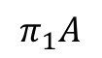
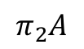
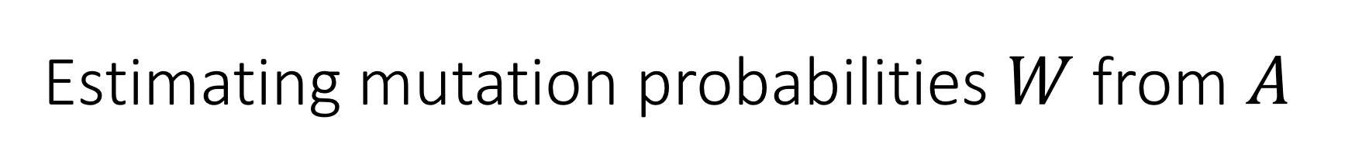
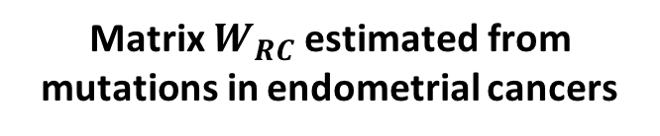
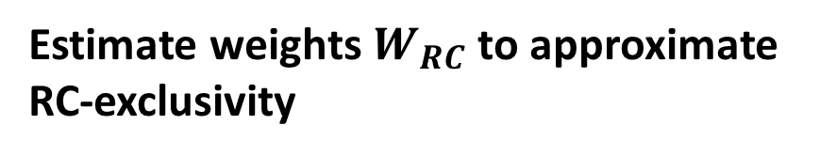
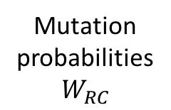
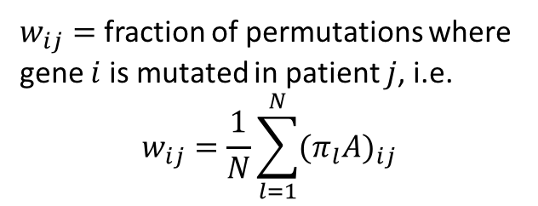
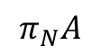
Estimating mutation probabilities $W$ from $A$
Estimate weights $W_{RC}$ to approximate RC-exclusivity
Matrix $W_{RC}$ estimated from mutations in endometrial cancers
Generate $N$ permutations of $A$ (whole matrix)
Fix row and column sums of $A$
$$⋯$$
# of mutations
Genes
$$π_{1}A$$
$$π_{2}A$$
$$⋯$$
$$π_{N}A$$
$w_{ij}=$ fraction of permutations where gene $i$ is mutated in patient $j$, i.e.
$$w_{ij}=\frac{1}{N}\sum_{l=1}^{N}{{(π_{l}A)}_{ij}}$$
Mutation probabilities$W_{RC}$
# of mutations
Patients

Slide 18
Results
Use our Weighted Exclusivity Test (WExT) software to:
Quickly and accurately compute R- and approximate RC-exclusivity
Identify exclusive mutations in hundreds of tumors from TCGA
Endometrial (UCEC)
Colorectal (COADREAD)
Thyroid (THCA)
High and highly variable mutation rates!
Software: http://github.com/raphael-group/wext

Slide 19
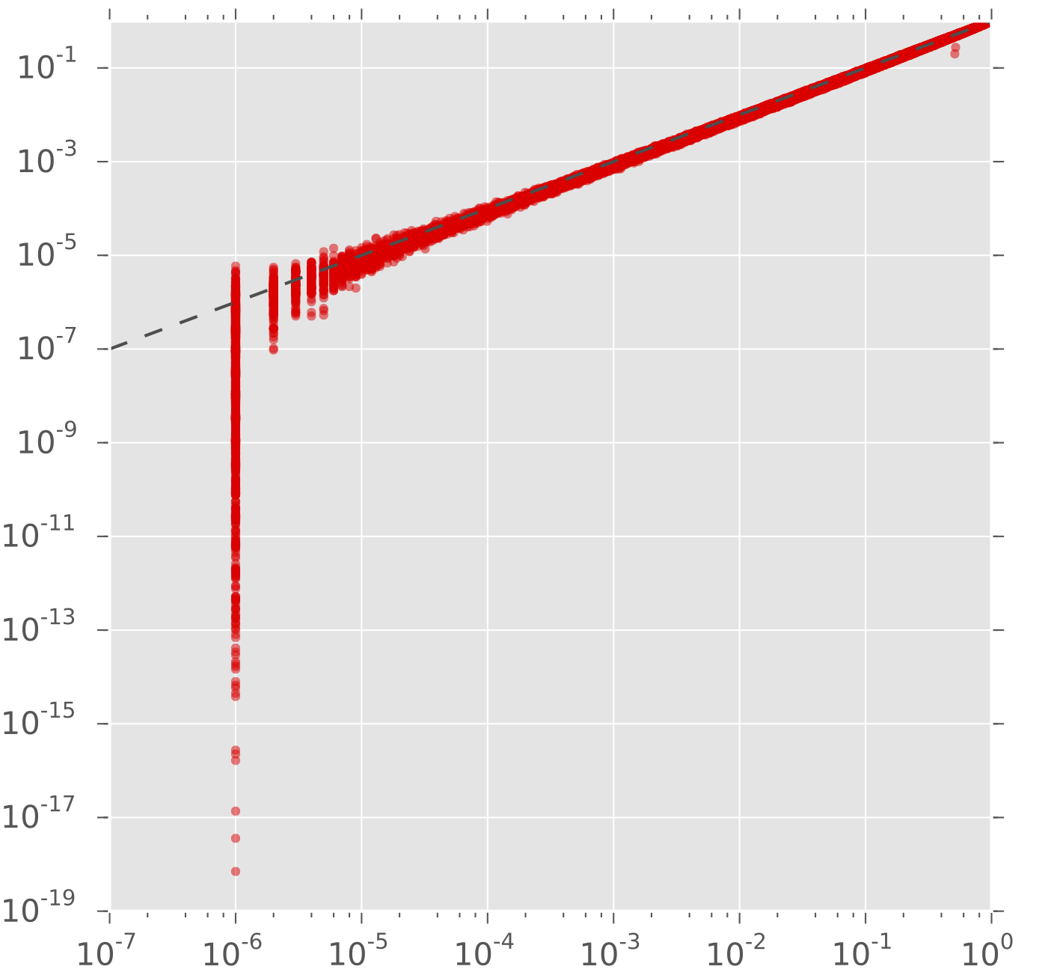


WExT approximates RC-exclusivity
Experimental design
Weights $W_{RC}$ estimated with $N={10}^{3}$ permutations
RC-exclusivity computed with $N={10}^{6}$ permutations
Results
p-values are strongly correlated in the tail (p < 0.001)
WExT is orders of magnitude faster (~30 minutes) versus RC-exclusivity permutation test (>1 day)
WR-exclusivity p-value (saddlepoint)
p-values below precision for permutation test
$$ρ^{2}=0.986$$
RC-exclusivity p-value (permutations)
Notes:
Use WExT to approximate RC-exclusivity -> Estimates for weights W to approximate the permutational -> use fewer permutations to estimate W_RC -> plot -> strong correlation in tail -> very fast

Slide 20

WExT reduces bias towards long genes and hypermutator mutations
$Φ_{WR}$ Rank | $Φ_{R}$ Rank | Triple | $$Φ_{WR}$$ | $$Φ_{R}$$ | Mutated hypermutators
1 | 22 | CTNNB1, RPL22, TP53 | 1.34E-41 | 2.11E-10 | 47 (58%)
2 | 44 | CTNNB1, KRAS, TP53 | 2.21E-37 | 3.05E-09 | 48 (59%)
3 | 55 | CTNBB1, MLL4, TP53 | 9.99E-36 | 4.26E-08 | 42 (52%)
4 | 57 | CTCF, CTNBB1, TP53 | 5.94E-35 | 4.84E-08 | 43 (53%)
5 | 60 | CTNBB1, RYR1, TP53 | 1.66E-34 | 1.14E-07 | 40 (49%)
WR-exclusivity (WExT):
6/7 predictions are known cancer genes (CTNNB1, RPL22, TP53, KRAS, MLL4, CTCF)
Top five triples in endometrial cancers according to WExT.
Genes with proteins longer than 11,000 amino acids → more likely to be mutated randomly.
CTNNB1 (74)
= hypermutator
TP53 (69)
= non-hypermutator
RPL22 (31)
Coverage: 64.52% (160/248 patients)

Slide 21

WExT reduces bias towards long genes and hypermutator mutations
$Φ_{WR}$ Rank | $Φ_{R}$ Rank | Triple | $$Φ_{WR}$$ | $$Φ_{R}$$ | Mutated hypermutators
1 | 22 | CTNNB1, RPL22, TP53 | 1.34E-41 | 2.11E-10 | 47 (58%)
2 | 44 | CTNNB1, KRAS, TP53 | 2.21E-37 | 3.05E-09 | 48 (59%)
3 | 55 | CTNBB1, MLL4, TP53 | 9.99E-36 | 4.26E-08 | 42 (52%)
4 | 57 | CTCF, CTNBB1, TP53 | 5.94E-35 | 4.84E-08 | 43 (53%)
5 | 60 | CTNBB1, RYR1, TP53 | 1.66E-34 | 1.14E-07 | 40 (49%)
20 | 1 | CACNA1E, PTEN, TP53 | 4.08E-30 | 3.11E-12 | 77 (95%)
21 | 2 | LAMA2, PTEN, TP53 | 5.76E-30 | 4.13E-12 | 77 (95%)
28 | 3 | PTEN, RYR2, TP53 | 3.29E-29 | 4.60E-12 | 78 (96%)
24 | 4 | NBEA, PTEN, TP53 | 2.21E-29 | 8.40E-12 | 76 (94%)
35 | 5 | FAT4, PTEN, TP53 | 2.04E-28 | 12.3E-11 | 75 (93%)
WR-exclusivity (WExT):
6/7 predictions are known cancer genes (CTNNB1, RPL22, TP53, KRAS, MLL4, CTCF)
R-exclusivity (CoMEt):
Only 2/7 predictions (TP53 and PTEN) are known cancer genes
Top five triples in endometrial cancers according to WExT (top) and CoMEt (bottom).
Genes longer than 11,000 amino acids → more likely to be mutated randomly.

Slide 22



Summary & Future Directions
New weighted test for mutually exclusive mutations
Improved analysis of cancer types with high and highly variable mutation rates
Future directions
Pan-Cancer analysis?
Different weighting schemes?
Mutation probabilities $W$
5
14
15
14
$m$ genes
10
5
7
14
12
9
3
3
3
2
3
2
7
3
2
3
2
6
3
4
3
2
3
3
2
4
3
2
7
2
3
2
3
4
2
2
2
3
2
2
2
1
$n$ patients

Slide 23

Acknowledgements
Co-authors
Benjamin Raphael
Matthew Reyna
Funding and Data
Raphael Research Group
Preprint: Coming soon!
See http://compbio.cs.brown.edu/projects/wext
Software: http://github.com/raphael-group/wext

